Slide 1
Upcoming Events
hi

Slide 2
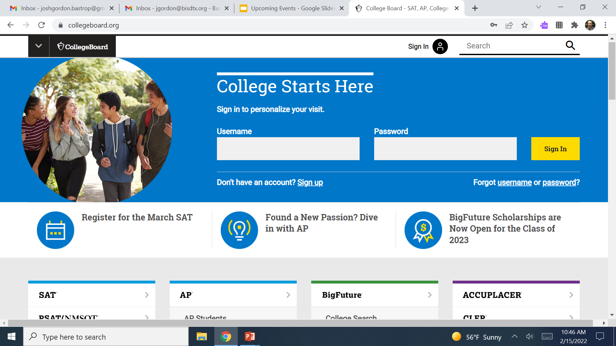
SAT Registration
You can sign up for the SAT on www.collegeboard.org

Slide 3
SAT Registration
If you have questions about registering for the SAT please see
Mr. Gordon. It is $52.
What score do I need?
There is no one answer to this question.
It depends on which universities you are applying to and what majors. An engineering major applying to UT will require a higher SAT than an English major applying to Texas State.

Slide 4
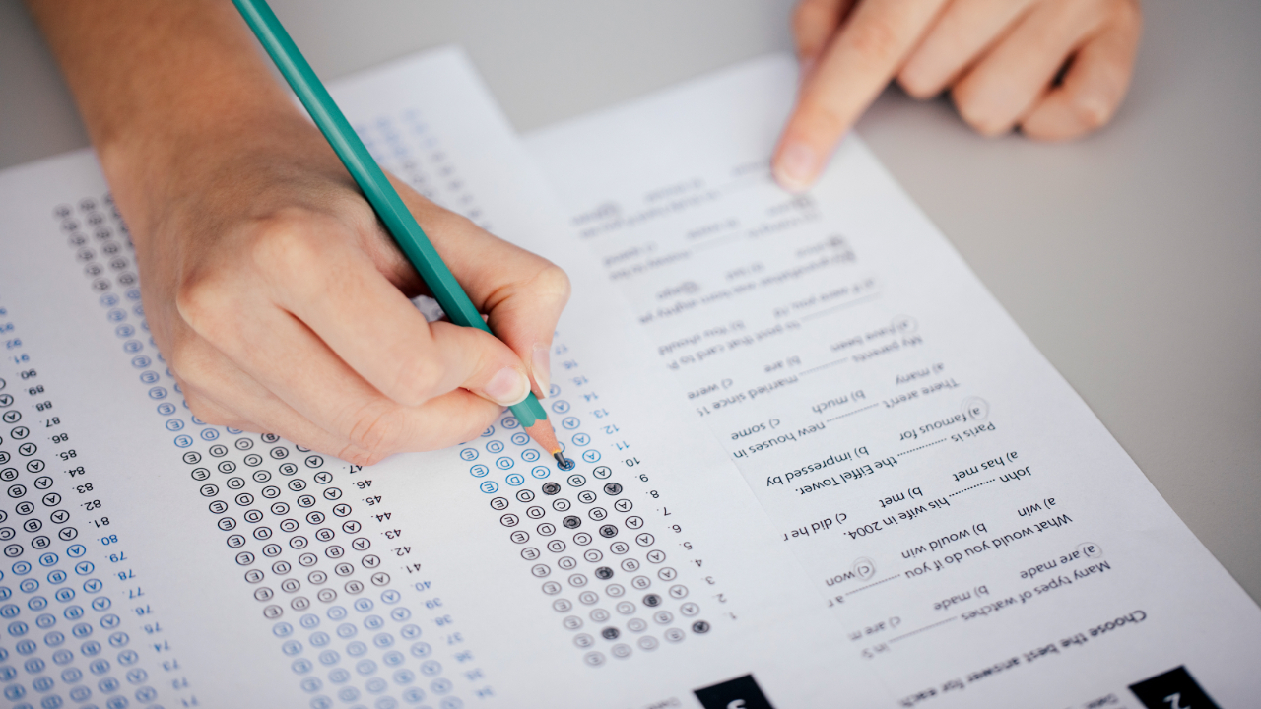
SAT BASICS
You can list four free colleges to send your scores to at the time of registration or until nine days after taking the test. This is the fastest way, but you will not find out your scores before they are sent to the college.
If you wait until after the nine days, it is $12 per college to have your scores sent.
You will find out your score approximately 3 weeks after your test day.

